Slide 1
Module 4: Normalization (Part-2)

Slide 2
Agenda
3NF – Third Normal Form
General Definitions and Examples
BCNF – Boyce-Codd Normal Form
General Definition and Examples
Properties of Relational Decompositions
Dependency Preservation property
Nonadditive (Lossless) Join property (testing)
Algorithms for Relational Database Schema Design
Dependency preserving and Nonadditive (Lossless) Join decomposition into 3NF and BCNF
Examples for 3NF and BCNF

Slide 3
3NF (Third Normal Form)
General Definition of 3NF
A given relation R is in 3NF, if for every FD X → Y in F⁺,
(i) Y ⊆ X (trivial); or
(ii) each attribute A in Y-X is contained in CK of R i.e. it is prime; or
(iii) X is a super key.

Slide 4
3NF (Third Normal Form) – Example 1
Consider R = {S, A, I, P} and F = {SI → P, S → A}
Using Algorithm 15.2(a) (see next slide)
CK = SI (the only candidate key) and A is nonprime
The FD SI → P doesn’t violate 3NF definition.
The FD, S → A violates 3NF definition, because S is not a superkey.
So, R in NOT in 3NF
In fact, S → A is a partial dependency (S is a subset of the key)
Decomposed 3NF relations (remove A from R):
R1(S, I, P) with F = {SI → P} in 3NF
R2(S, A) with F = {S → A} in 3NF

Slide 5
Finding Candidate Keys (Algorithm 9.1)
Algorithm 9.1. Finding a Key K for R Given a set F of Functional Dependencies
Input: A relation R and a set of functional dependencies F on the attributes of R.
1. Set K := R.
2. For each attribute A in K
{
compute (K – A)⁺ with respect to F;
if (K – A)⁺ contains all the attributes in R,
then set K := K – {A}
};

Slide 6
Finding Candidate Keys (Algorithm 9.2)
Algorithm CandidateKey(R, F)
1. LS ← φ; RS ← φ; BS ← φ; CK ← φ // CK – Candidate key
2. For each FD do:
LS ← LS ∪ all attributes appearing only in LHS
RS ← RS ∪ all attributes appearing only in RHS
BS ← BS ∪ all attributes appearing on both the sides
3. If LS = φ and RS = φ Then
use the algorithm of [3] – exhaustive method
4. If LS⁺ = R then
CK ← CK ∪ LS
Return CK.
5. For each attribute A ∈ BS do:
LS ← LS ∪ A
If LS⁺ = R Then CK ← CK ∪ LS
LS ← LS – A
6. Return CK.

Slide 7
Exercise 1
Consider R (A, B, C, G, H, I), and F = {A → BC, CG → HI, B → H}.
Find all Candidate keys of R.
Solution:
Using Algorithm 9.2,
LS = {A, G}; RS = {H, I}; BS = {B, C}
AG⁺ = {AG}
AG⁺ = {AGBC} because of FD1
AG⁺ = {AGBCHI} because of FD2
Since AG determines all the attributes of R, hence this is the only CK.

Slide 8
Exercise 2
Consider R(A, B, C, D, E, H), and F = {A → B, AB → E, BH → C, C → D, D → A}
Find all Candidate keys of R.
Solution:
Using Algorithm 9.2,
LS = {H}; RS = {E}; BS = {A, B, C, D}
H⁺ = {H}
H⁺ = {H} no change, so pick A from “BS” set
HA⁺ = {HABECD}
Since HA determines all the attributes of R, hence this is a CK.
Similarly, HB, HC, HD are candidate keys.

Slide 9
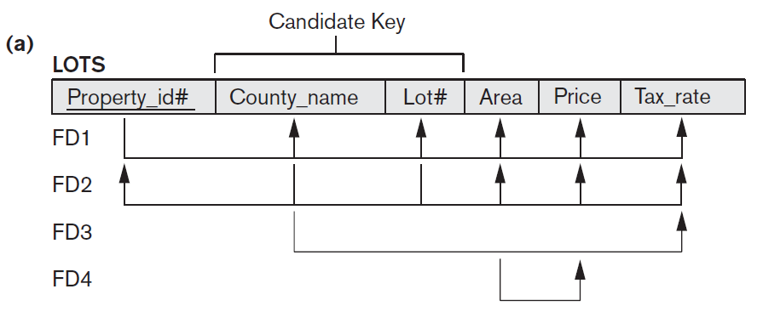
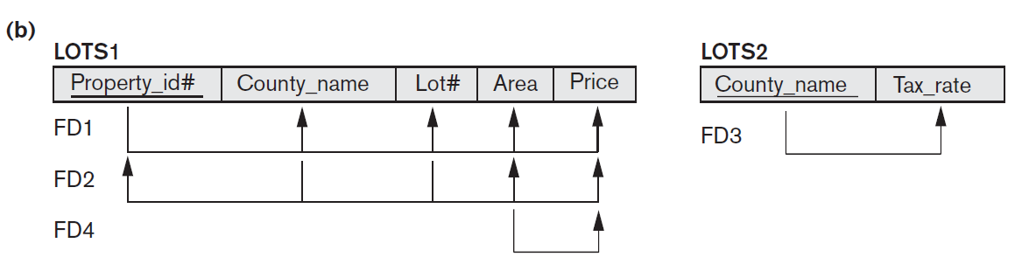
3NF (Third Normal Form) – Example 2
Consider the relation LOTS
LOTS1 not in 3NF, but LOT2 in 3NF
FD4 in LOTS1 violates 3NF because Area is not a superkey and Price is not a prime attribute in LOTS1.

Slide 10
Example 2 (Contd.)
LOTS1 not in 3NF, but LOT2 in 3NF
FD1 = {Property_id# → County_name, Lot#, Area, Price}
FD2 = {County_name, Lot# → Property_id#, Area, Price}
FD4 = {Area → Price}
CKs = {Property_id#} and {Lot#, County_name}
FD1 & FD2 – no violation
But, FD4 violates the definition, because Area is not a superkey and
Price is not a prime attribute in LOTS1.
Area – acts as transitive dependency attribute.

Slide 11
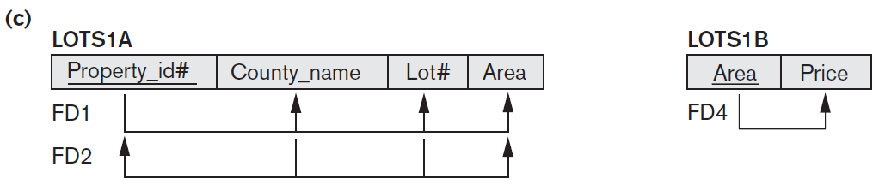
Example 2 (Contd.)
To normalize LOTS1 into 3NF, we decompose it into the relation schemas LOTS1A and LOTS1B.
LOTS1A – remove the attribute Price that violates 3NF from LOTS1
Place it with Area (the left hand side of FD4 that causes the transitive dependency) into another relation LOTS1B. Both LOTS1A and LOTS1B are in 3NF.
LOTS1A = [{Property_id# → County_name, Lot#, Area},
{County_name, Lot# → Property_id#, Area}]
LOTS1B = {Area → Price}

Slide 12
Interpreting the General Definition
of Third Normal Form
A relation schema R violates the general definition of 3NF if a functional dependency X → Y holds in R that does not meet all three conditions. This can occur due to two types of problematic functional dependencies:
A nonprime attribute determines another nonprime attribute. Here we typically have a transitive dependency that violates 3NF.
A proper subset of a key of R functionally determines a nonprime attribute. Here we have a partial dependency that violates 3NF (and also 2NF).
General alternative definition of 3NF
A relation schema R is in 3NF if every nonprime attribute of R meets both of the following conditions:
It is fully functionally dependent on every key of R.
It is nontransitively dependent on every key of R.

Slide 13
Boyce-Codd Normal Form (BCNF)
Every relation in BCNF is also in 3NF; however, a relation in 3NF is not necessarily in BCNF.
BCNF is simpler form of 3NF, but stronger than 3NF.
Definition: A relation R is in BCNF if for every FD X → Y in F⁺,
(i) Y ⊆ X (trivial); or
(ii) X is a superkey
Note that the second condition in 3NF definition is missing here,; thus making BCNF stronger.

Slide 14
3NF versus BCNF
A relation is in 3NF if it is in 2NF and there are no transitive dependencies.
What about a case in which a non-key attribute is the determinant of a key attribute?
This condition does not violate 3NF, but does violate BCNF. Because, BCNF expects that every determinant in the relation be a candidate key.
Example:
AB → CD C → B
A | B | C | D

Slide 15
3NF versus BCNF (contd.)
Example:
How to decompose this table and make it BCNF?
Decompose Rule (Ullman):
If the violating FD is: X → A, then
D = {R – A} and {XA}
R(A, B, C, D), F = {AB → CD, C → B}
CK = {AB} and D = {ACD, CB}
AB → CD C → B
A | B | C | D

Slide 16

Decomposition of Relations not in BCNF
Example
FD1: {Student, Course} → Instructor
FD2: Instructor → Course each instructor teaches only one course
CK = {Student, Course} as per Algorithm 9.2
Possible BCNF decompositions
{Student, Instructor} and {Student, Course}.
{Course, Instructor} and {Course, Student}.
{Instructor, Course} and {Instructor, Student}.
All three decompositions lose the functional dependency FD1.
The desirable properties are: nonadditive (lossless and FD preservation)
So 3rd decomposition satisfies both the properties.

Slide 17
Nonadditive (lossless) Join Test for Binary Decomposition
As per the following theorem of Ullman
Theorem: Let F be a set of FDs over R, and D = {R1, R2} be a decomposition of R. D is a lossless-join decomposition if and only if
R1 ∩ R2 → R1 - R2 is in F⁺ or
R1 ∩ R2 → R2 - R1 is in F⁺
Example
Consider R(ABC), F = {A → B}
Decompose R into AB and AC. AB ∩ AC = A and AB – AC = B
So, A → B holds. This means the decomposition is lossless.
However, if we decompose R into AB and BC, then
AB ∩ BC = B and AB – BC = A or BC – AB = C
This means that the decomposition is lossy!

Slide 18
Nonadditive (lossless) Join Test for Binary Decomposition (Contd.)
Example
Consider R (City, Street, Zipcode) or R (C, S, Z) and
F = {CS → Z, Z → C}.
CK1 = {CS} and CK2 = {ZS} (using Algorithm 5.2(a))
The relation R is in 3NF (since each attribute is prime) but not in BCNF, because in Z → C, Z is not a superkey and also it is not a trivial FD. In R, we cannot store the city to which a zipcode belongs unless we know a street address with the zipcode. This introduces insertion anomaly.
To convert this into BCNF, decompose R into: R1 = {Z, C} and R2 = {S, Z}
Any relation schema with exactly two attributes is in BCNF.

Slide 19
BCNF Checking
For each functional dependency X → Y in R calculate X⁺.
If X⁺ includes all the attributes of R, then it is in BCNF, otherwise it is not.

Slide 20
BCNF Checking - Example 1
Consider R (City, Street, Zipcode) or R (C, S, Z) and
F = {CS → Z, Z → C}.
Attribute Closure
(CS)⁺ = (C, S, Z) and Z⁺ = (Z, C).
The second FD does not include all attributes and hence R is not in BCNF.

Slide 21
BCNF Checking - Example 2
FD1: {Student, Course} → Instructor and
FD2: Instructor → Course
(Student, Course)⁺ = (Student, Course, Instructor)
(Instructor)⁺ → (Instructor, Course)
Since FD2 doesn’t include all attributes, it is not in BCNF.

Slide 22
Properties of Relational Decompositions
Relation Decomposition and Insufficiency of Normal Forms
Dependency Preservation Property of a Decomposition
Nonadditive (Lossless) Join Property of a Decomposition

Slide 23

(a) Relation Decomposition and Insufficiency of Normal Forms
The set F of functional dependencies that should hold on the attributes of R is specified by the database designers and is made available to the design algorithms.
Using the functional dependencies, the algorithms decompose the universal relation schema R into a set of relation schemas D = {R₁, R₂, ..., R_{m}} that will become the relational database schema; D is called a decomposition of R.
We must make sure that each attribute in R will appear in at least one relation schema R_{i} in the decomposition so that no attributes are lost; formally, we have
This is called the attribute preservation condition of a decomposition.

Slide 24
(b) Dependency Preservation Property of a Decomposition
Dependency preservation condition - each functional dependency X→Y specified in F either appeared directly in one of the relation schemas R_{i} in the decomposition D or could be inferred from the dependencies that appear in some R_{i}.
Why should we need to preserve the FD? - each dependency in F represents a constraint on the database.
Definition: We say that a decomposition D = {R₁, R₂, ..., R_{m}} of R is dependency-preserving with respect to F if the union of the projections of F on each R_{i} in D is equivalent to F; that is, ((πR₁(F)) ∪ ... ∪ (πR_{m}(F)))⁺ = F⁺.

Slide 25
Projecting a set of FDs onto a Subset of the Attributes (Example-1)
Suppose we have R(ABCDE) with these F = {A → C, C → E, E → BD}
Project the FDs onto attributes ABC.
Solution
To project onto a set of attributes, we systematically consider every possible LHS of an FD that might hold on those attributes.
A⁺ = ACEBD, therefore A → BC. (It also functionally determines DE, but these are not in our set of attributes.)
B⁺ = B. This yields no FDs for our set of attributes.
C⁺ = CEBD, therefore C → B.
We don't need to consider any supersets of A. A already determines all of our attributes ABC, so supersets of A will only yield FDs that already follow from A → BC.
The only remaining subset of the attributes ABC to consider is BC. BC⁺ = BCED. This yields no FDs for our set of attributes.
So the projection of the FDs onto ABC is: {A → BC, C → B}

Slide 26
Testing Dependency Preservation of Decomposition (Example-2)
Consider R(CSZ) and F = {CS → Z, Z → C}
Assume D = {R1(SZ), R2(CZ)}. Does this decomposition preserve the dependencies?
Solution
F1 = ∏_{SZ}(F) = No non-trivial FDs
F2 = ∏_{CZ}(F) = Z → C
F ≠ F1 ∪ F2
Since this decomposition does not imply CS → Z, we conclude that there is no dependency preservation.

Slide 27
Example-3
Consider the relation Booking(Title, Theater, City) with FDs
F = {Theater → City, {Title, City} → Theater}
CK1 = {Title, Theater} and CK2 = {Title, City} using Algorithm 9.2
This relation is not in BCNF, because of violating FD Theater → City
Hence, the decomposed relations:
D = {Booking1(Title, Theater), Booking2(Theater, City)}
Does it preserve the FDs?
NO!
F1: No FDs
F2: {Theater →City}
F ≠ F1 ∪ F2

Slide 28
(c) Nonadditive (Lossless) Join Property of a Decomposition
No spurious tuples are generated when a NATURAL JOIN operation is applied to the relations resulting from the decomposition, D.
Definition: Formally, a decomposition D = {R₁, R₂, ..., R_{m}} of R has the lossless (nonadditive) join property with respect to the set of dependencies F on R if, for every relation state r of R that satisfies F, the following holds, where * is the NATURAL JOIN of all the relations in D: *(πR₁(r), ..., πR_{m}(r)) = r.
The nonadditive join property ensures that no spurious tuples result after the application of PROJECT and JOIN operations.

Slide 29
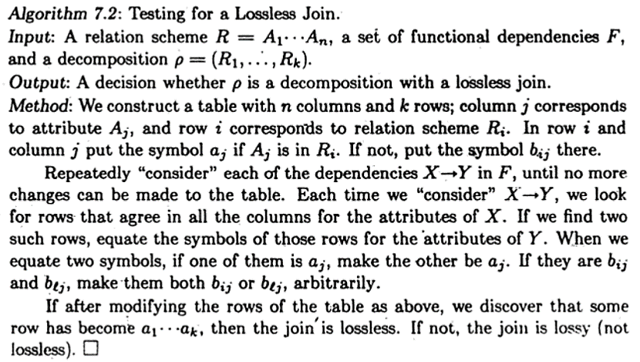
Testing for Nonadditive (Lossless) Join Property

Slide 30
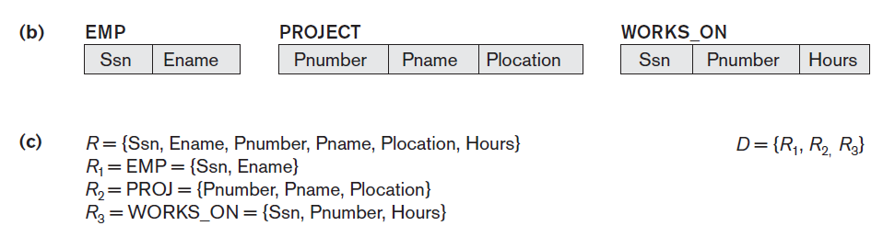
Example-1
Consider the following relation and its decomposition:
F = {Ssn → Ename; Pnumber → {Pname, Plocation}; {Ssn, Pnumber} → Hours}
Initial Table (R₁ has Ssn and Ename and so use “a” symbols, and so on.)
 | Ssn | Ename | Pnumber | Pname | Plocation | Hours
R₁ | a1 | a2 | b13 | b14 | b15 | b16
R₂ | b21 | b22 | a3 | a4 | a5 | b26
R₃ | a1 | b32 | a3 | b34 | b35 | a6

Slide 31
Example-1 (Contd.)
After applying FD: Ssn → Ename
Equate R₁ and R₃
 | Ssn | Ename | Pnumber | Pname | Plocation | Hours
R₁ | a1 | a2 | b13 | b14 | b15 | b16
R₂ | b21 | b22 | a3 | a4 | a5 | b26
R₃ | a1 | b32 a2 | a3 | b34 | b35 | a6

Slide 32
Example-1 (Contd.)
After applying FD: Pnumber → {Pname, Plocation}
Pnumber → Pname and Pnumber → Plocation
Equate R₂ and R₃ then R₂ and R₃
 | Ssn | Ename | Pnumber | Pname | Plocation | Hours
R₁ | a1 | a2 | b13 | b14 | b15 | b16
R₂ | b21 | b22 | a3 | a4 | a5 | b26
R₃ | a1 | b32 a2 | a3 | b34 a4 | b35 | a6
 | Ssn | Ename | Pnumber | Pname | Plocation | Hours
R₁ | a1 | a2 | b13 | b14 | b15 | b16
R₂ | b21 | b22 | a3 | a4 | a5 | b26
R₃ | a1 | b32 a2 | a3 | b34 a4 | b35 a5 | a6
last row is all “a” symbols so we stop and it’s lossless.

Slide 33
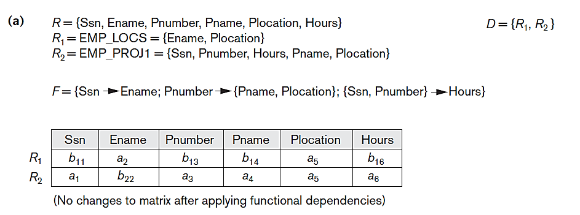
Example-2
No row has all “a” symbols. Hence, it’s lossy.

Slide 34
Example-3
Consider R(A, B, C, D, E)
F = {A → C, B → C, C → D, DE → C, CE → A}
R1(AD), R2(AB), R3(BE), R4(CDE), R5(AE)
 | A | B | C | D | E
R1 | a1 | b12 | b13 | a4 | b15
R2 | a1 | a2 | b23 | b24 | b25
R3 | b31 | a2 | b33 | b34 | a5
R4 | b41 | b42 | a3 | a4 | a5
R5 | a1 | b52 | b53 | b54 | a5

Slide 35
Example-3 : FD1
R(A, B, C, D, E)
FD = A → C
Rows 1, 2, 5 will need to change the values for the RHS attribute C – equate b13, b23, b53 to b13 (you might very well have picked b23 or b53 to equate all three).
We won’t change the rows 3 & 4 yet because their symbols b31, b41 are different from a1.
 | A | B | C | D | E
R1 | a1 | b12 | b13 b13 | a4 | b15
R2 | a1 | a2 | b23 b13 | b24 | b25
R3 | b31 | a2 | b33 | b34 | a5
R4 | b41 | b42 | a3 | a4 | a5
R5 | a1 | b52 | b53 b13 | b54 | a5

Slide 36
Example-3 : FD2
R(A, B, C, D, E)
FD = B → C
Consider rows 2 and 3 only. Equate b33 with b13
 | A | B | C | D | E
R1 | a1 | b12 | b13 b13 | a4 | b15
R2 | a1 | a2 | b23 b13 | b24 | b25
R3 | b31 | a2 | b33 b13 | b34 | a5
R4 | b41 | b42 | a3 | a4 | a5
R5 | a1 | b52 | b53 b13 | b54 | a5

Slide 37
Example-3 : FD3
R(A, B, C, D, E)
FD = C → D
 | A | B | C | D | E
R1 | a1 | b12 | b13 b13 | a4 | b15
R2 | a1 | a2 | b23 b13 | b24 a4 | b25
R3 | b31 | a2 | b33 b13 | b34 a4 | a5
R4 | b41 | b42 | a3 | a4 | a5
R5 | a1 | b52 | b53 b13 | b54 a4 | a5

Slide 38
Example-3 : FD4
R(A, B, C, D, E)
FD = DE → C
Equate b13 (all occurrences) with a3
 | A | B | C | D | E
R1 | a1 | b12 | b13 b13 a3 | a4 | b15
R2 | a1 | a2 | b23 b13 a3 | b24 a4 | b25
R3 | b31 | a2 | b33 b13 a3 | b34 a4 | a5
R4 | b41 | b42 | a3 | a4 | a5
R5 | a1 | b52 | b53 b13 a3 | b54 a4 | a5

Slide 39
Example-3 : FD5
R(A, B, C, D, E)
FD = CE → A
Equate b31, b41, and a1.
 | A | B | C | D | E
R1 | a1 | b12 | b13 b13 a3 | a4 | b15
R2 | a1 | a2 | b23 b13 a3 | b24 a4 | b25
R3 | b31 a1 | a2 | b33 b13 a3 | b34 a4 | a5
R4 | b41 a1 | b42 | a3 | a4 | a5
R5 | a1 | b52 | b53 b13 a3 | b54 a4 | a5
It is Lossless, because Row 3 has all “a” symbols.

Slide 40
Algorithms for Relational Database Schema Design
Dependency-Preserving and Nonadditive Join Decomposition into 3NF Schemas
It is not possible to have all three of the following:
Guaranteed non-lossy design (it is a must)
Guaranteed dependency preservation (desirable)
All relations in BCNF (not mandatory)

Slide 41
Algorithm for 3NF
Algorithm 3NF_Relations(R, F)
// Relational synthesis into 3NF with dependency preservation and
// Nonadditive Join Property
Step-1: G = Call MinimalCover (F).
Step-2: For each left-hand-side X of a functional dependency that appears in G, create a relation schema in D with attributes {X ∪ {A₁} ∪ {A₂} ... ∪ {A_{k}} }, where X→A₁, X→A₂, ...,X→A_{k} are the only dependencies in G with X as the left-hand-side (X is the key of this relation)
Step-3: If no relation in D contains a key for R, then create a new relation schema that contains attributes to form a key for R.
Step-4: Eliminate redundant relations from the resulting set of relations in the relational database schema. A relation R is considered redundant if R is a projection of another relation S in the schema; alternately, R is subsumed (include or contain) by S.

Slide 42
Example-1
Consider EMPPROJ(Emp_ssn, Pno, Esal, Ephone, Dno, Pname, Plocation)
FD1: Emp_ssn → {Esal, Ephone, Dno}
FD2: Pno → { Pname, Plocation}
FD3: Emp_ssn, Pno → {Esal, Ephone, Dno, Pname, Plocation}
The CK of EMPPROJ is {Emp_ssn, Pno}
Step-1 [Call MinimalCover()] :
F = { Emp_ssn → Esal
Emp_ssn → Ephone
Emp_ssn → Dno
Pno → Pname,
Pno → Plocation
{Emp_ssn, Pno} → Esal
{Emp_ssn, Pno} → Ephone
{Emp_ssn, Pno} → Dno
{Emp_ssn, Pno} → Pname
{Emp_ssn, Pno} → Plocation }.

Slide 43
Example-1 (Contd.)
Step-1: All FDs in F have single attributes on RHS.
Check for redundant attributes on LHS.
{Emp_ssn, Pno} → Esal Pno is redundant
{Emp_ssn, Pno} → Ephone Pno is redundant
{Emp_ssn, Pno} → Dno Pno is redundant
{Emp_ssn, Pno} → Pname Emp_ssn is redundant
{Emp_ssn, Pno} → Plocation Emp_ssn is redundant
Hence, all these FDs are redundant.
So, G = {Emp_ssn → Esal
Emp_ssn → Ephone
Emp_ssn → Dno
Pno → Pname
Pno → Plocation}

Slide 44
Example-1 (Contd.)
Step-2: D = { R1(Emp_ssn, Esal, Ephone, Dno)
R2(Pno, Pname, Plocation) }
Step-3: D does not have the key of EMPPROJ. So, we need to create a third relation.
D = { R1(Emp_ssn, Esal, Ephone, Dno)
R2(Pno, Pname, Plocation)
R3(Emp_ssn, Pno }
Step-4: None of the above relations is redundant. Hence, D is unaltered.

Slide 45
Example-2
Given a relation R(A, B, C, D, E, F, G) and F = {AB → C, A → D, BD → C, D → BG, AE → F}
Finding Minimal cover of F is as follows:
Step-1: G = F
Step 2: G = {AB → C, A → D, BD → C, D → B, D → G, AE → F}
Step 3: The only FDs to be considered are
AB → C, BD → C, AE → F.
For AB → C, we want to find whether A → C or B → C holds or not.
Because A → D, D → B implies A → B (transitivity).
Because A → B implies A → AB.
Because A → AB, AB → C implies A → C (transitivity).
Thus, G - {AB → C} ∪ {A → C} ≡ G.

Slide 46
Example-2 (Contd.)
Similarly, BD → C can be replaced by D → C,
because D → B implies D → BD, and
D → BD, BD → C implies D → C.
However, AE → F cannot be replaced by any other FD.
The result of Step-3 is given below:
G = {A → C, A → D, D → C, D → B, D → G, AE → F}
Step-4: A → C can be removed from G, because A → D,
D → C implies A → C.
The minimal cover of original F is:
G = {A → D, D → C, D → B, D → G, AE → F}

Slide 47
Example-2 (Contd.)
Now applying Step-2 of Algorithm 3NF_Relations(), we have
D = { R1(A, D), R2(D, C, B, G), R3(A, E, F) }
For Step-3, we need the CK of R. We compute CK of R as (A, D, E). Since ADE isn’t appearing in any of the relations of D, we create a new relation R4(A, D, E)
As per Step-4, the relation R4 is subsumed by R1, and hence the final D is
D = { R1(D, C, B, G), R2(A, E, F), R3(A, D, E) }

Slide 48
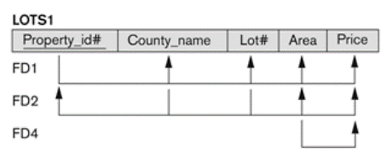
Example-3
Consider the relation LOTS1 and its functional dependencies F.
F = { P → LCA, LC → AP, A → C }
Minimum cover = G = {P → LC, LC → AP, A → C }.
In step 2 of Algorithm 3NF_Relations( ) we produce design X (before removing redundant relations) as
Design X: R1(P, L, C), R2(L, C, A, P), and R3(A, C).
In step 4 of the algorithm, we find that R3and R1are subsumed by R2. Hence, both of those relations are redundant.
Design X (Final 3NF): R2(L, C, A, P).

Slide 49
2) Nonadditive Join Decomposition into
BCNF Schemas
Algorithm BCNF(R, F)
{
D = {R}
while there is a relation schema Q in D that is not in BCNF;
{
Choose a relation schema Q that is not in BCNF
Find an FD, X → Y in Q that violates BCNF
Replace Q in D by two schemas (Q – Y) and (X ∪ Y)
}
}

Slide 50
Example-1
Consider R = {ABCDE} and F = {A→BC, BC→A, BCD→E, E→C}
CK = {AD, BCD}.
Check each FD in R for possible violation of BCNF.
FD1: A is not a superkey; FD2: BC is not a superkey;
FD3: BCD is a superkey; FD4: E is not a superkey
Therefore R is not in BCNF and should be decomposed as:
R1 = (ABC) {A→BC, BC→A} in BCNF (superkey = {A, BC})
R2 = (BCDE) {BCD→E, E→C} not in BCNF (E→C and E is not a uperkey)
We continue decomposing R2 into
R21= (BDE) no FDs. R21 is in BCNF
R22= (EC) {E→C} E is a superkey R22 is in BCNF.
Final solution: Scheme D= {ABC, BDE, EC} is in BCNF

Slide 51
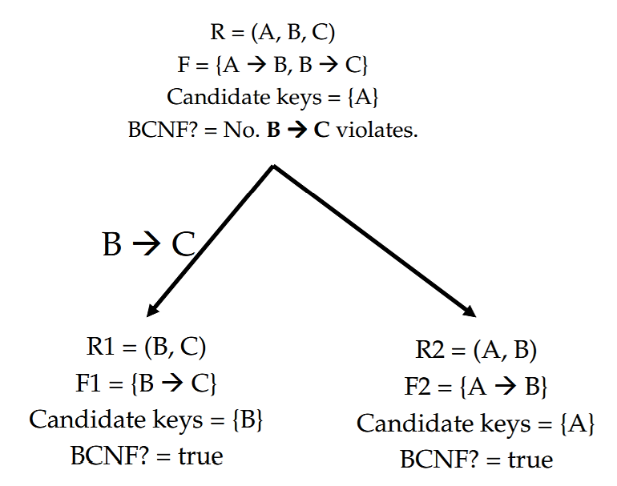
Example-2

Slide 52
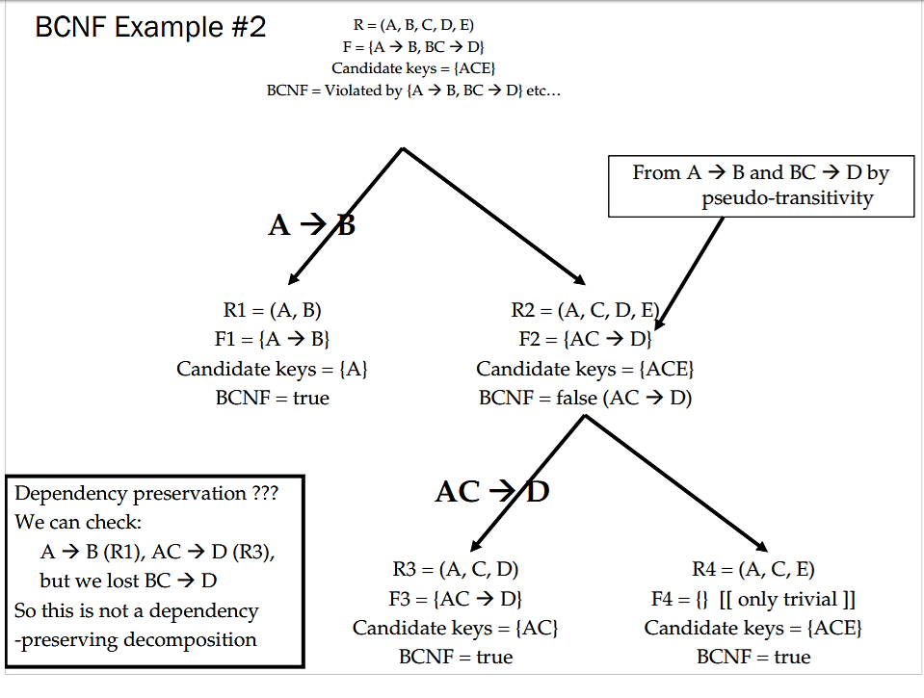
Example-3
Design X

Slide 53
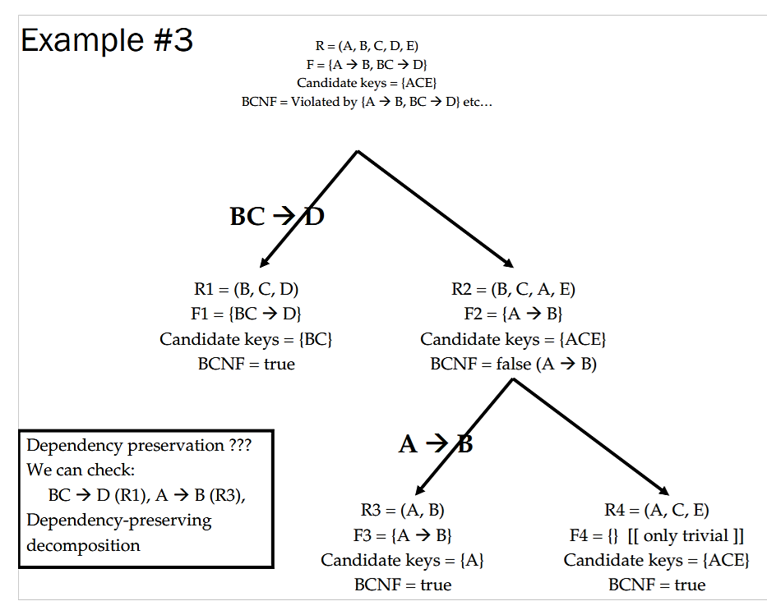
Example-3 (Contd.)
Design Y

Slide 54
Exercise
Given R(A, B, C, D) and F = {B → C, AC → D}. Normalize R and test whether it preserves the dependencies and a lossless join.
Solution:
CK = {AB}
Not in 3NF as per the definition.
D = {R1(BC), R2(ACD)} with F1 = {B → C} and F2 = {AC → D}
Now R1 and R2 are in 3NF and BCNF.
It does preserve the dependencies, because F = F1 ∪ F2.
Check R1∩ R2 → R1 – R2 or R2 – R1
(BC) ∩ (ACD) → BC – ACD or ACD – BC does not hold
Therefore, it is not lossless decomposition.
Note: Test using the matrix method also.

Slide 55
Exercise
Given R(A, B, C, D) and F = {B → C, AC → D}. Normalize R and test whether it preserves the dependencies and a lossless join.
Solution:
CK = {AB}
Not in 3NF as per the definition.
D = {R1(BC), R2(ACD)} with F1 = {B → C} and F2 = {AC → D}
Now R1 and R2 are in 3NF and BCNF.
It does preserve the dependencies, because F = F1 ∪ F2.
Check R1∩ R2 → R1 – R2 or R2 – R1
(BC) ∩ (ACD) → BC – ACD or ACD – BC does not hold
Therefore, it is not lossless decomposition.
Note: Test using the matrix method also.

Slide 56
Fourth Normal Form (4NF)
Multivalued Dependencies (MVD)
HSTB
Subject | Teacher | Book
OOP | SN SKM | OOP with C++ OOSD
Data Structures | SN | Fundamentals of DS Introduction to DS Design of Algorithms

Slide 57
4NF - HSTB
The following constraints hold on HSTB
For a given subject there can be any number of teachers who can teach and any number of books that could be referred as text.
Actually there is no dependency between the Teacher and Book. This means that irrespective of who teaches the subject, the same books are referred.
A given teacher or book may be associated with any number of subjects.

Slide 58
Decomposition
The relation HSTB is not in 1NF.
Even by making it into 1NF, redundant data exist.
Solution:
ST (Subject, Teacher)
SB (Subject, Book)
Both the relations are in BCNF.

Slide 59
MVD & 4NF: Definitions
MVD Def: A relation R (X, Y, Z) is said to have multivalued dependency (MVD) X →→ Y if the set of Y values, for a given (X, Z) pair, does not depend on Z but depends only on X, then we say X →→ Y, “X multi-determines Y” or “Y is multi-dependent on X” then such an FD is called as Multivalued Dependency (MVD) and is represented by a double arrow →→.
4NF Def: A relation schema R is in 4NF with respect to a set of dependencies F (that includes functional dependencies and multivalued dependencies) if, for every nontrivial multivalued dependency X →→ Y in F⁺, X in F⁺, X is a superkey for R.
Subject →→ Teacher
Subject →→ Book
Or, Subject →→ Teacher | Book
The decomposed relations are {S, T} & {S, B}

Slide 60
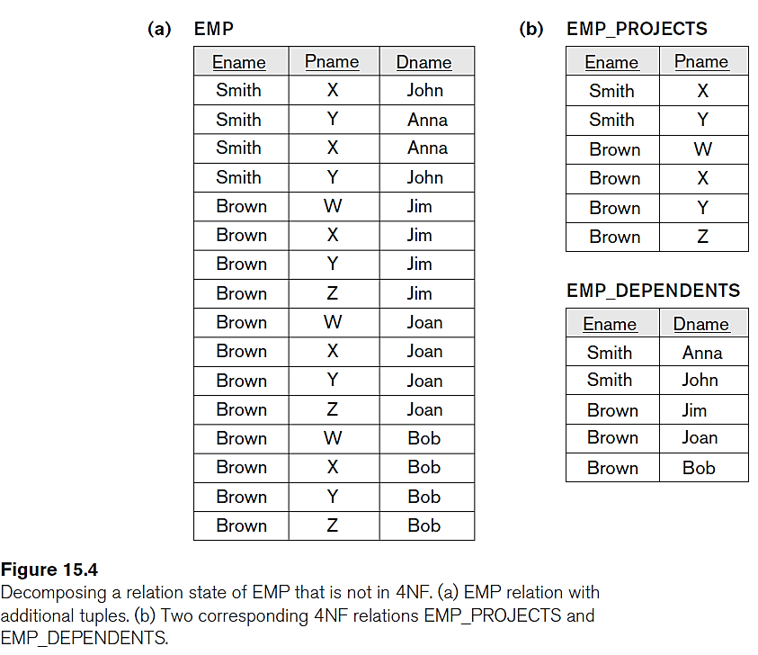
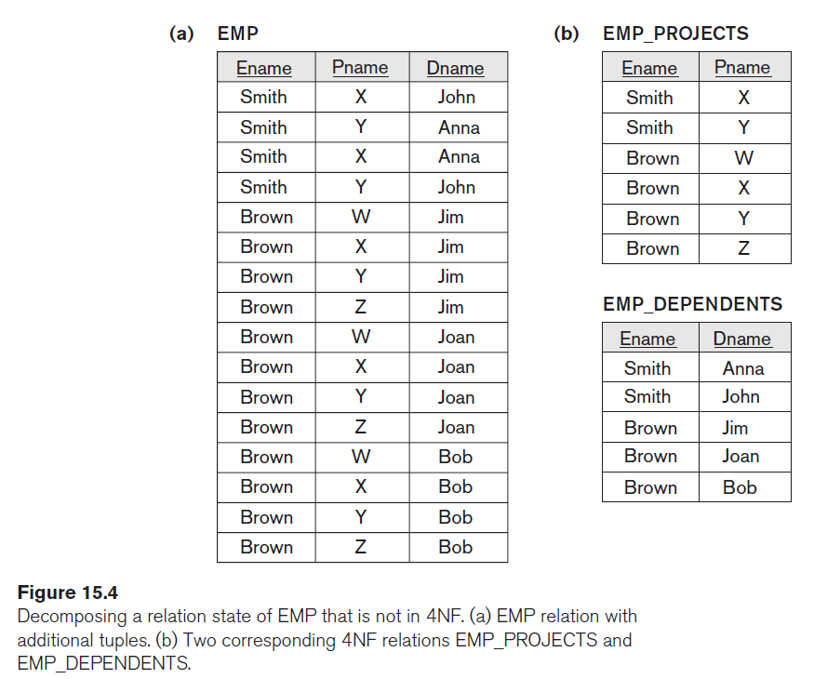
Example

Slide 61
Fifth Normal Form (5NF)
Join-dependency: A relation R satisfies join dependency (R1, R2, …., Rn) if and only if R is equal to the join of R1, R2, …., Rn where Ri are subsets of the set of attributes of R.
Definition: A relation R is in 5NF (or Project-Join Normal Form, PJNF) if for all join-dependencies at least one of the following holds:
(R1, R2, …., Rn) is a trivial join-dependency
(i.e. one of Ri is R)
Every Ri is a candidate key for R

Slide 62
Example-1
Agent | Company | Product
Smith | Ford | Car
Smith | GM | Truck
The goal
Agents represent companies, companies make products, and agents sell products.
We might want to keep track of which agent sells which product for which company.
Agent | Company | Product
Smith | Ford | Car
Smith | Ford | Truck
Smith | GM | Car
Smith | GM | Truck
Jones | Ford | Car

Slide 63
Normalized Relations
Agent | Company
Smith | Ford
Smith | GM
Jones | Ford
Agent | Company | Product
Smith | Ford | Car
Smith | Ford | Truck
Smith | GM | Car
Smith | GM | Truck
Jones | Ford | Car
Agent | Product
Smith | Car
Smith | Truck
Jones | Car
Company | Product
Ford | Car
Ford | Truck
GM | Car
GM | Truck

Slide 64
Summary

